Slide 1
SXR tomography on AUG
Tomáš Odstrčil
todstrci@ipp.mpg.de

Slide 2
Installation
Not necessary, can be directly started on Linux clusters by command pytomo
Installation from IPP gitlab
module load git
git clone http://gitlab.aug.ipp.mpg.de/todstrci/pytomo.git
cd ./pytomo
./pytomo.sh

Slide 3
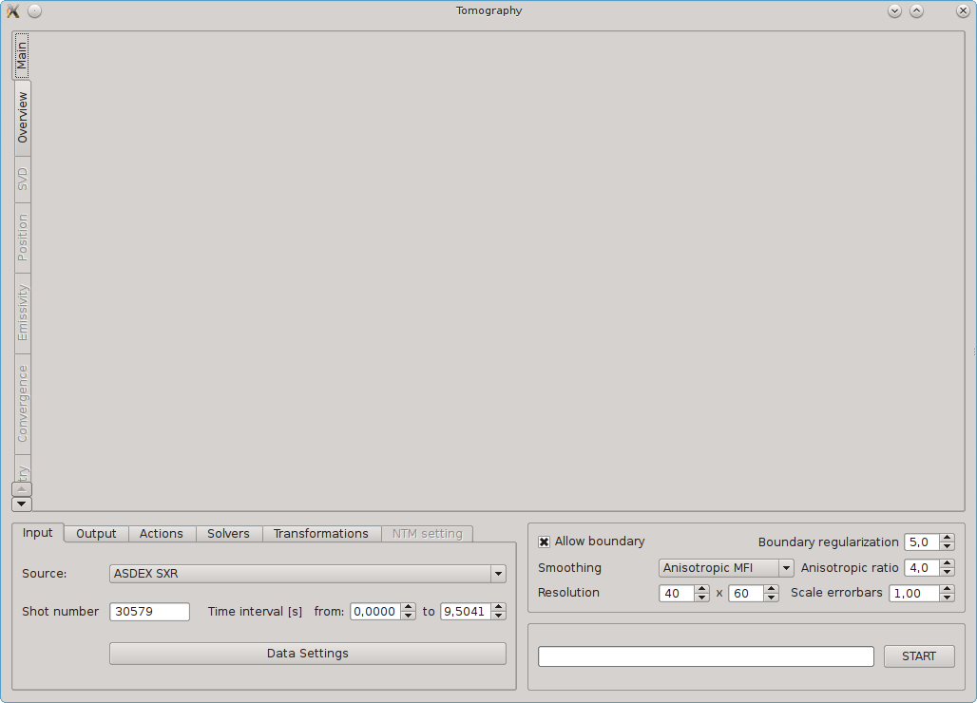
Basic use
1) Select diagnostic
2) Select discharge and time range
3) Check data, remove corrupted LOS, downsample
4) Press start

Slide 4
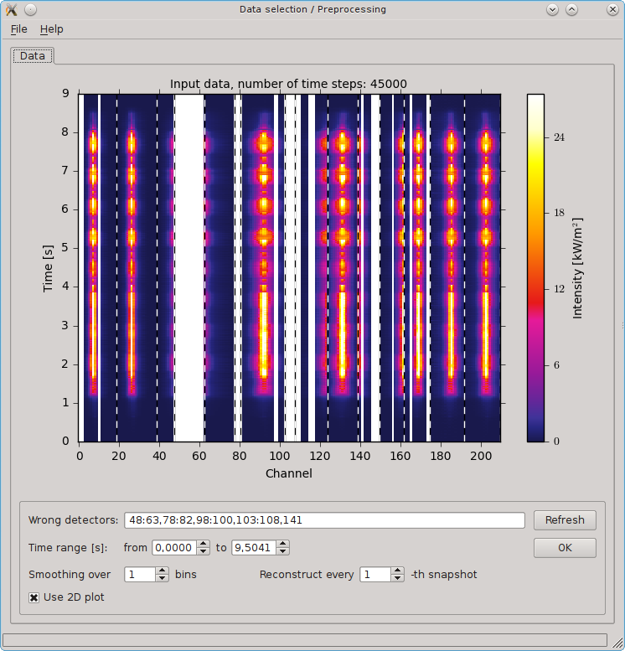
Data selection
Check very carefully for corrupted or very noisy channels and remove them
Select one time point to visualize 1D profile and check very carefully for jumps in signal and suspicious values close to zero
In future, also possibility for FFT analysis will be included
List of wrong LOS
1) Moving average, 2) decimate signal

Slide 5
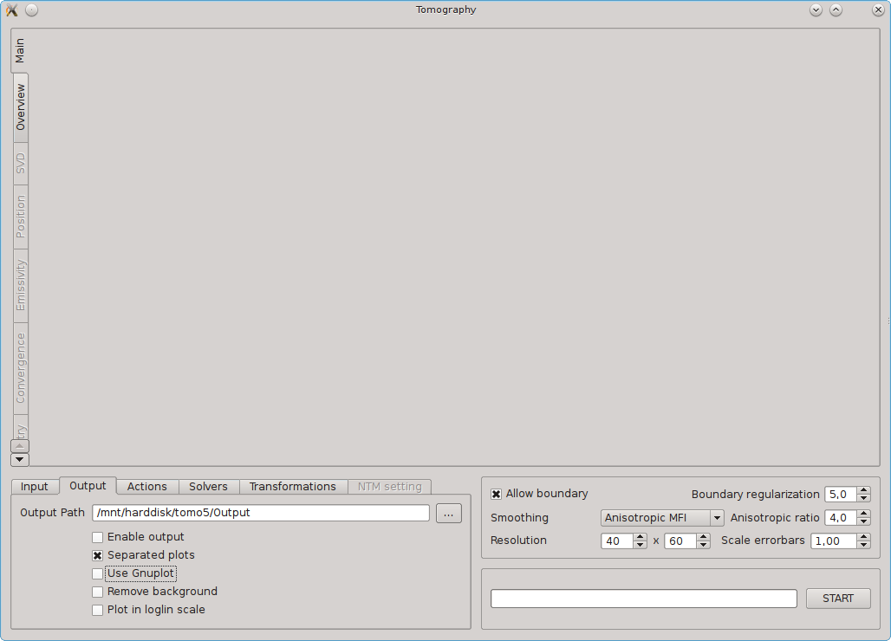
Reconstruction options
Smoothing
Isotropic MFI
Anisotropic MFI – best for SXR
Isotropic MNGR – very peaked or off-axis SXR profiles
Anisotropic IMGES – best for divertor reconstruction
Resolution – up to 200x300, time scales linearly with num. pixels
Allow boundary – press reconstruction to zero at boundary (turn off for bolometers)
Anisotropic ration – ratio between parallel and radial smoothing
Scale error bars
Scale error bars by a constant factor
Do not affect reconstruction with GCV and PRESS method

Slide 6
Output panel
Enable output
Save high quality plots (i.e. pdf)
Save also all other results to Output path
Separate plots
Plot emissivity and brightness for each time point
Can be slow!!
Remove Background – subtract average of all reconstruction or for 10% of time evolution (details in config file)
Plot in loglin scale
Nonlinear transformation by arcsinh(x/x₀)
For visualizing pedestal region and discharge with a large emissivity range

Slide 7
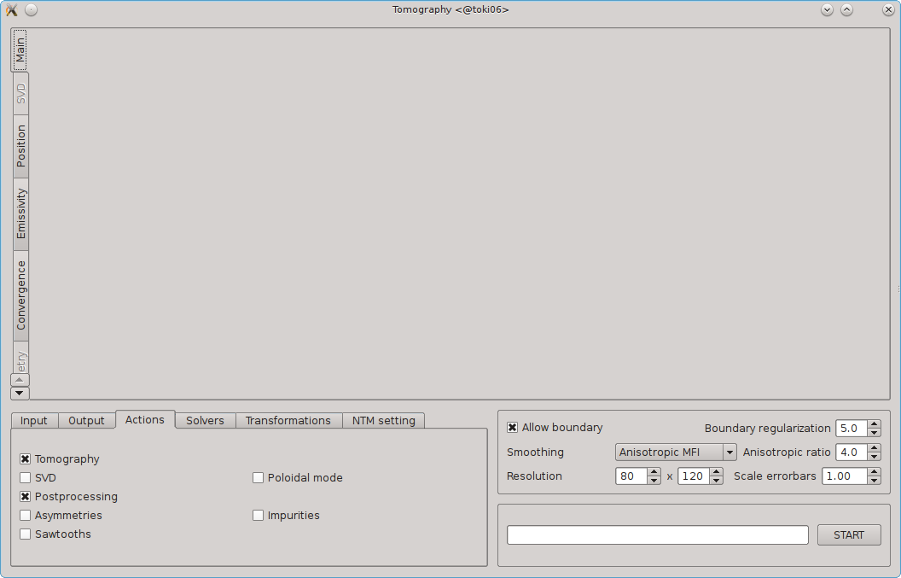
Actions panel
SVD
Remove 1. SVD component from the reconstructions
Perform SVD analysis
Post processing
Details about convergence, plasma position, emissivity
Asymmetry
Calculate poloidal asymmetry
Compared with simplifies centrifugal model
Sawtooths
Identify sawtooths times
Frequency and inversion radius
Run the tomography for SXR_slow diag without downsampling
Poloidal mode number
Estimate position and M-number of all modes in the reconstruction
Use with caution
Impurities
Calculate W density
Use IDA if available, else Thomson scattering

Slide 8
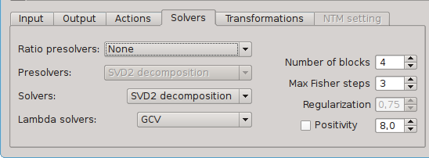
Solvers panel
Ratio presolver
Estimate and store cross-calibration between cameras
Run at least ones for each discharge!
Presolvers
Obsolete option to speed up intermediate steps in MFI regularization
Solvers
Tiknonov … - original solver, chi2=1 condition, slow O(n³)
SVD, SVD2, QR, GEV, GSVD – various decomposition methods, SVD2 is the fastest
Lambda solvers
Select proper regularization
GCV – preferred, PRESS – more conservative and table, AICc depends on error scale
Manual – select optimal level by hand – when PRESS and GCV failure
Number of blocks
speed up reconstruction by solving MFI for block is timeframes
Positivity
Number gives a weak positivity constrain, button force positivity strongly (slow, can be unstable)

Slide 9
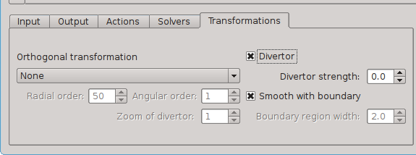
Transformation panel
Constrain reconstruction on the subspace given by the various radial basis functions
Abel – pyramid basis
Cormack - Zernike polynomial
Fourier-Bessel – Bessel functions
Radial order
Number of radial basic vectors
Angular order
Number of angularbasic vectors (cos and sin)
Divertor
Some attempt to improve smoothing in the divertor region

Slide 10
Outputs
Everything stored in ~/tomography/tmp/
When high quality output is enabled also to ~/tomography/Output/
Possibility to write shotfiles, but not integrated in GUI…
Possibility to write ASCII files, but not integrated in GUI…
Emissivity_1.5-5.1_rec_31595.npz
gres: 3D array, emissivity profile, float16! must by renormalized by gres_norm
BdMat: average boundary matrix
Input_parameters – used settings
Grid points centrods
postprocessing_31595.npz
And many other files… ☹

Slide 11
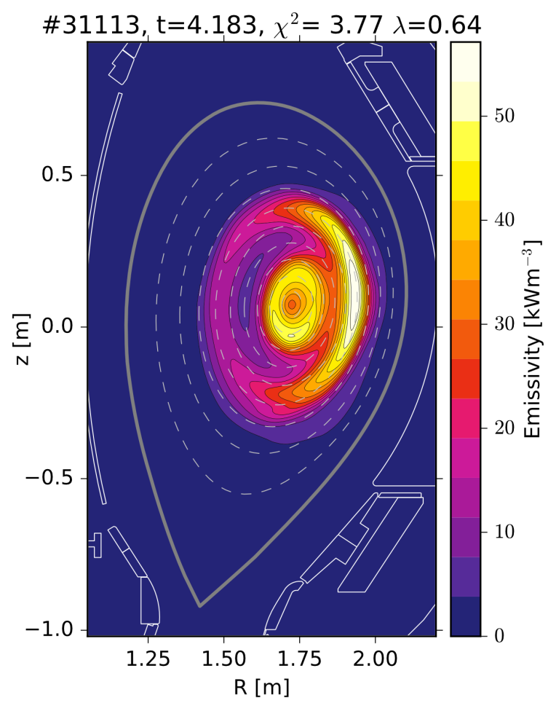
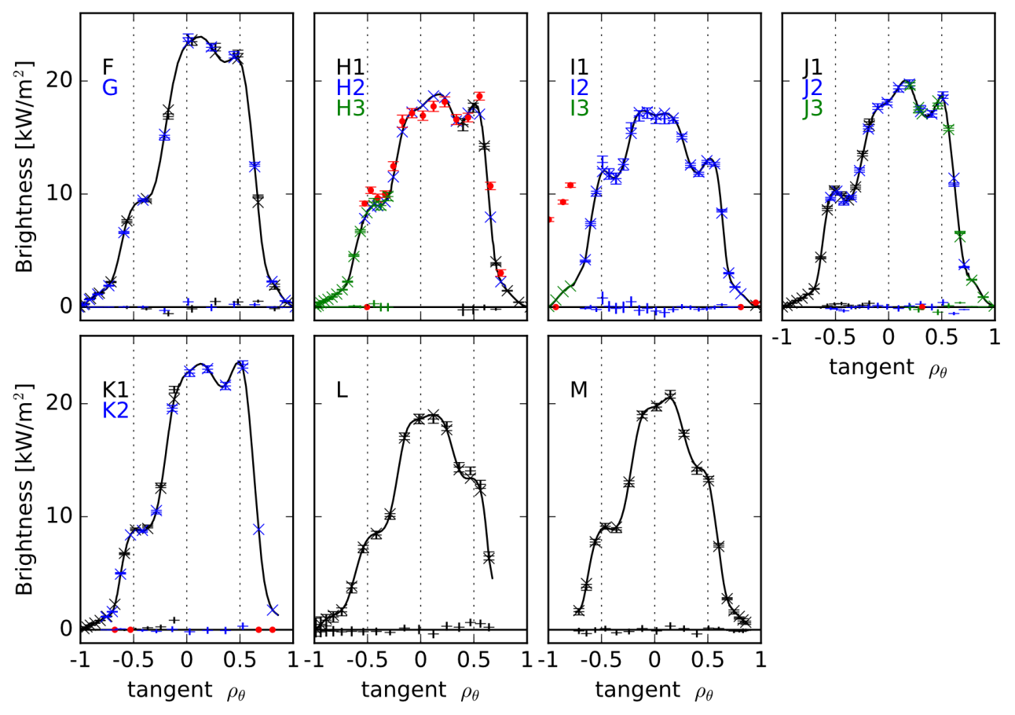
Example: SXR reconstruction
Hollow-peaked-hollow profile
Measured brightness mapped on the radial coordinate
Direct comparison between features in data and tomography!

Slide 12
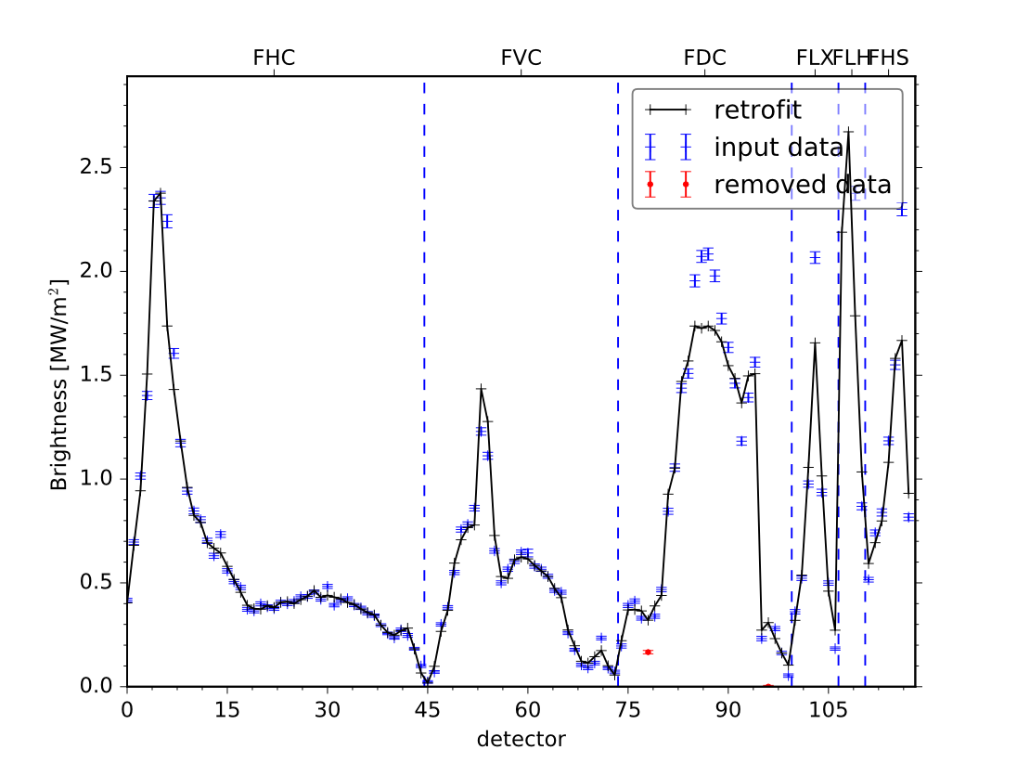
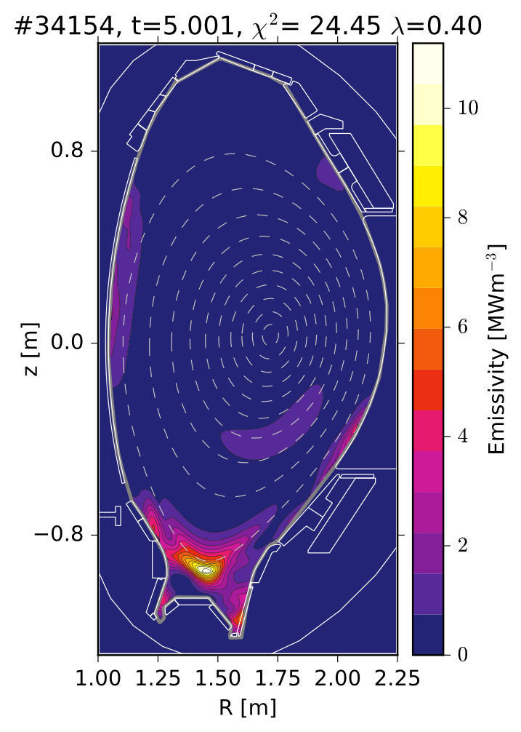
Example: Bolometers
Special setting necessary! use this command options
pytomo -t 11 -S 7 --positive_constrain -B 200 -u 30 -d 30 --boundary 0 --lambda_solver 0.4 --postprocessing -x 100 -y 150 -s -G 34154
It can be set as default option in the configuration file

Slide 13
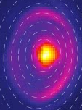
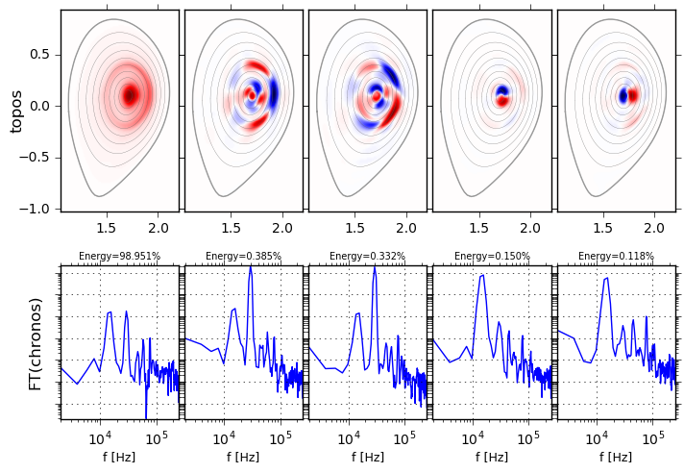
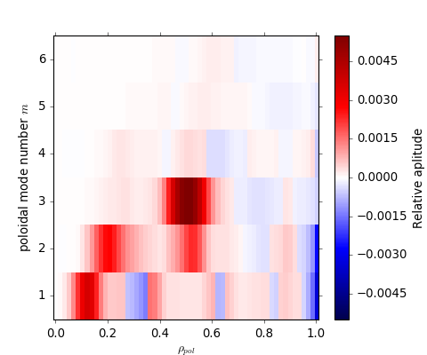
Example: 1/1, 2/2? and 3/2 mode
Reconstruction 29222 at 1.9046s
SVD analysis
Mode numbers profile
M = 1 , 2 ,3

Slide 14
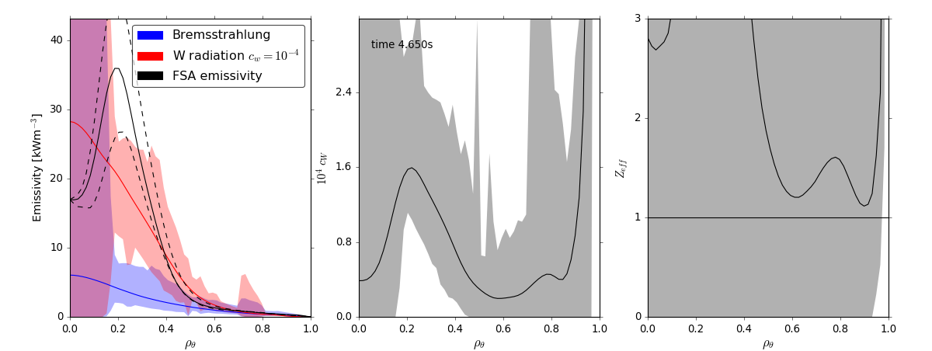
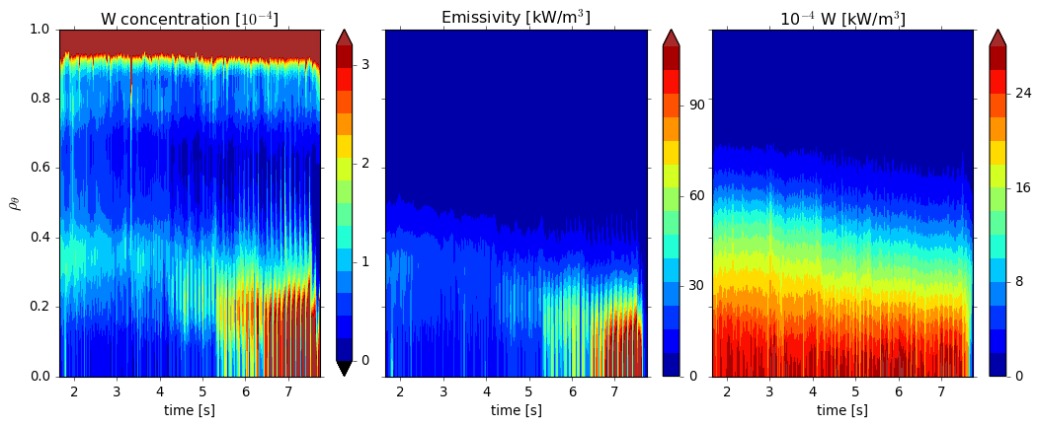
Example: Impurity analysis
Overestimated
errorbars!
Overestimated
errorbars!

Slide 15
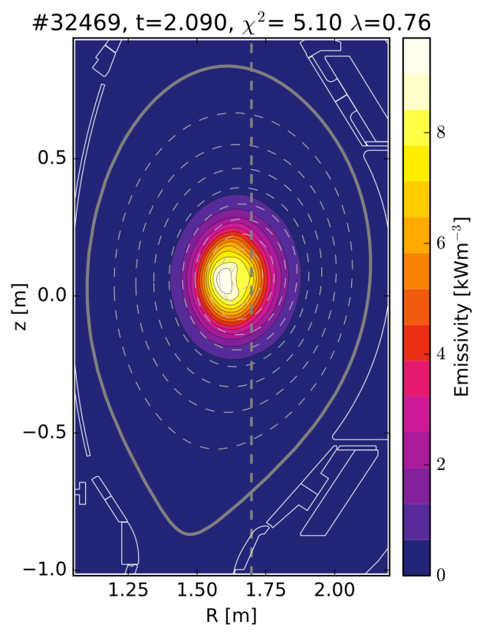
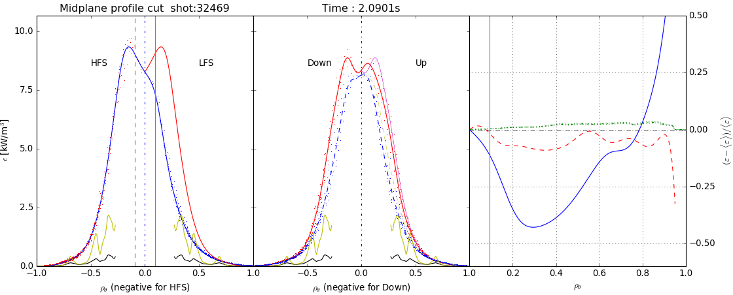
Example: Poloidal asymmetries
In-out and up-down asymmetry
Simple model for centrifugal asymmetry
If I will find a time, I will implement a new version...

Slide 16
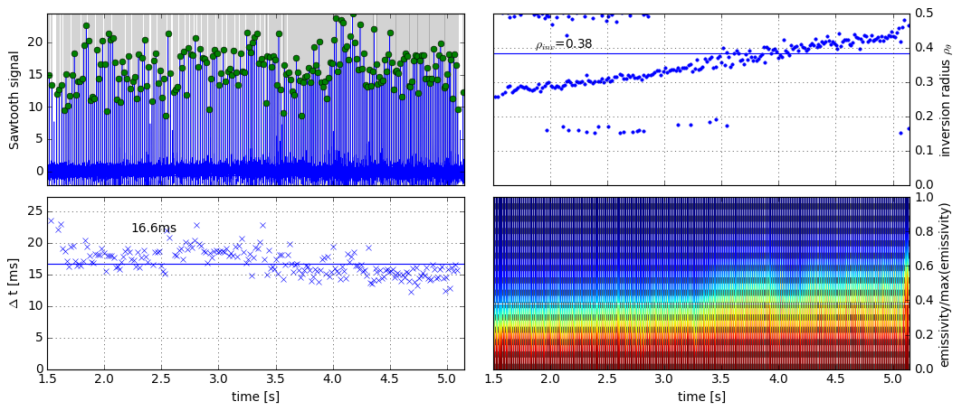
Example: Sawtooths
Discharge 32595 - current scan from 0.6-1MA
More than 95% crashes detected
High fidelity of inversion radius
Limitations – hollow profiles are difficult

Slide 17
For experts: config file
Default value for very option in GUI
For example
Shotfile with mag. equilibrium data
Generator of phantom profiles
Radial coordinate rho_{pol}, r/a, r_{V}
Parameters for sawtooths detector
Background subtraction options
Plotting options
Rescale emissivity for each plot separately
Show LOS, magnetic surfaces, theta star
Use contours for emissivity, color map
Plot brightness as function of rho tangential
SVD chromos in frequency domain
Number of SVD components

Slide 18
For experts: command line
Every option in GUI has also command line alternative
pytomo --help for complete list of options
Example
pytomo 30579 --tmin 4 --tmax 5 -s -u 5 -d 5
run w/o gui from 4 to 5s smooth and downsample over 5 frames, plot separate plots
Batch processing of discharges is possible
Missing robust and reliable detection of corrupted channels
Sometimes optimal regularization is not found

Slide 19
Geometry calibration
Accurate knowledge of the geometry of SXR diagnostic is essencial for reconstructions
Accuracy of in-situ measurements is usually insufficient
Therefore a self-consistent calibation is necessary and must by performed after every opening or even more often of a systematical discrepancies in backprojected brightness occures
1) select a set of dicharges from peaked to flat without poloidal asymmetry!
2) set this dicharges, times and other parameters in the script detector_optimization.py
3) run the script and wait until the optimization is finished
4) check results, save correction factors and repeat of other discharge

Slide 20
References
Odstrčil, T., et al. "Optimized tomography methods for plasma emissivity reconstruction at the ASDEX Upgrade tokamak." Review of Scientific Instruments 87.12 (2016): 123505.
Odstrčil, M., et al. "Modern numerical methods for plasma tomography optimisation.„ Nuclear Instruments and Methods in Physics Research Section A: Accelerators, Spectrometers, Detectors and Associated Equipment 686 (2012): 156-161.

